Slide 1
Machine Learning
( The study of algorithms that learn from experience and examples instead of relying on hardcoded rules.)

Slide 2
Why Machine Learning ?
Write a code for differentiating apples and oranges .
How many functions will you write ?
def detect_colors(image):
#code here
def detect_colors(image):
#code here
and so on.
Increased Computational power.
Most important being the TBs of data collected every hour.

Slide 3
Types of ML
Supervised ->The input (features) and output (label) is given to you .Just feed these as the training data and train your model.
Unsupervised -> No output (label) is given to the model. The algorithm will only give you the particular structure of the data based on the clusters formed in the input (features).

Slide 4
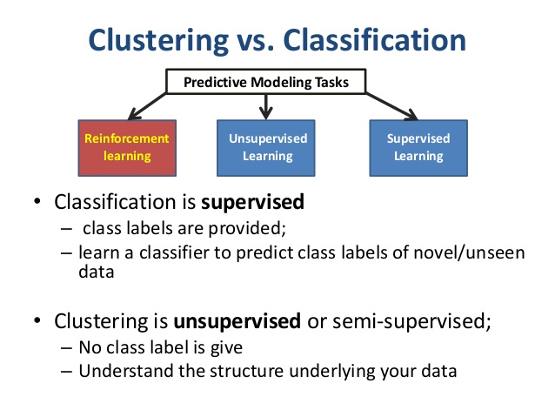
Supervised and Unsupervised Techniques

Slide 5
Conclusion
Supervised algorithms can apply what has been learned in the past(old data) to new data and helps predicting the new data(test data). Models used for classification–
Decision tree
Neural Networks
Unsupervised algorithms can draw inferences from datasets. Models used for clustering –
Density models
Centroid models (K-mean Clustering)

Slide 6
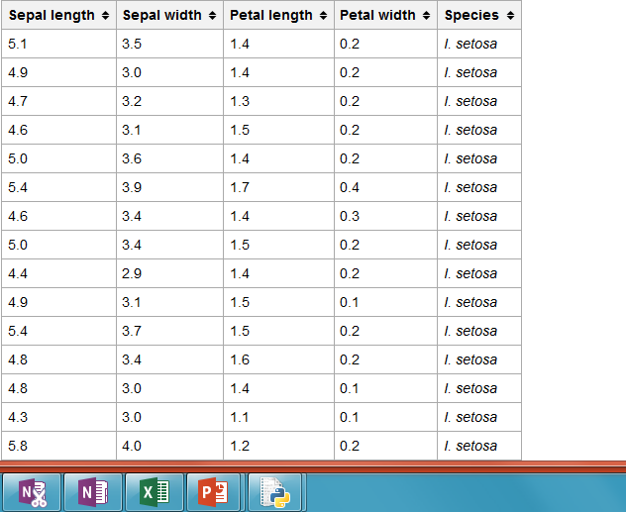
Implementing Supervised Learning using Decision Tree

Slide 7
Thank you

